Slide 1

Voyage Voyage
By Vladimira GROSJEAN – Samira TAIBI
and Fanny THIBERT

Slide 2
Summary
Functional specifications – Reminder
Backlog
Backend : db mysql / UML-API doc / API Tripadvisor / express / tests
Frontend : vue.js
Pages of the website
Bonus

Slide 3
1 - Functional specifications - Reminder :
Display tourist attractions, monuments, places for all countries
Users system with register / login and profile
Trip system : create and display
Activity system : create (for curators), display and add to trip
CRUD Admin with users, trips, activities and comments management
Cards with pointers
Bonus : music / google lighthouse…

Slide 4
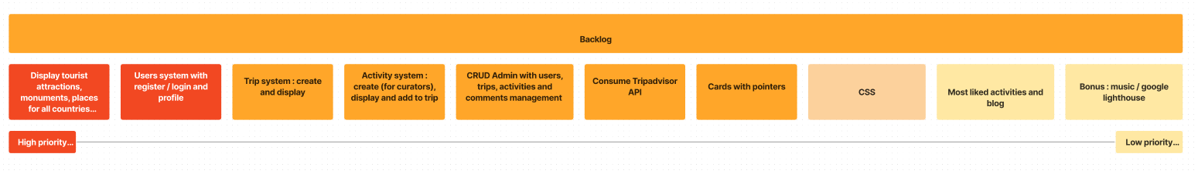
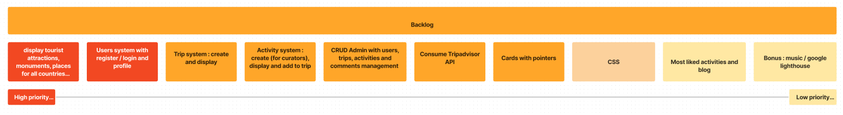
2 - Backlog

Slide 5
3 - Backend

Slide 6


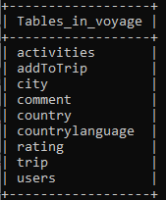
DB Mysql
Users
Country
City
Trip
Activities
Comments
Rating
addToTrip

Slide 7
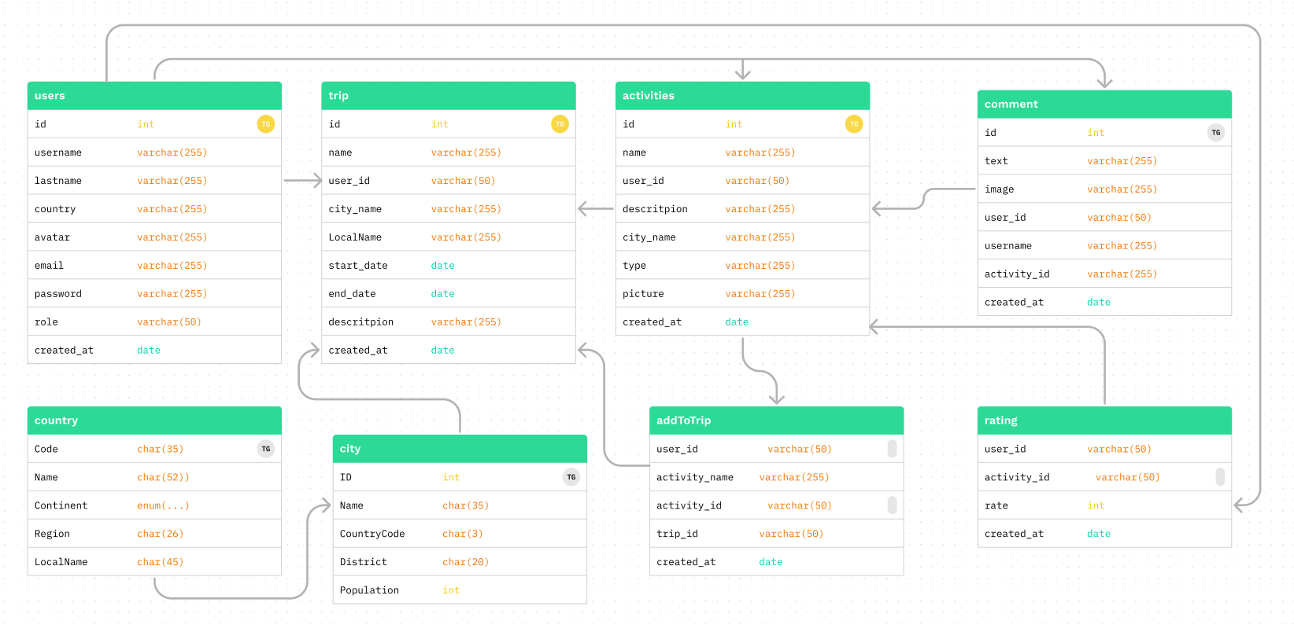
Diagramme UML => DB Mysql

Slide 8

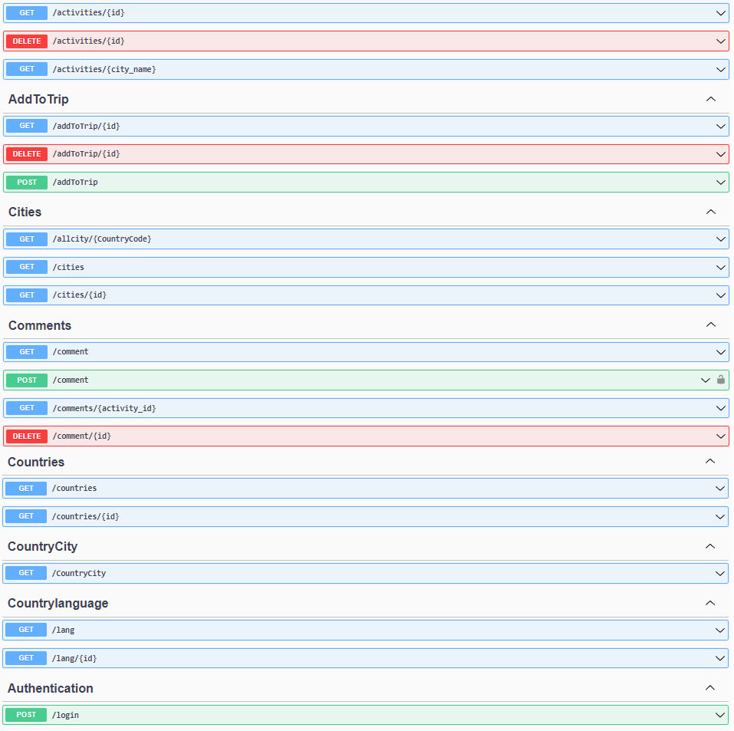
API Documentation : Swagger

Slide 9
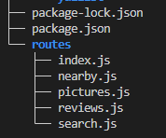
API Tripadvisor
Tree of TripAdvisor_API

Slide 10
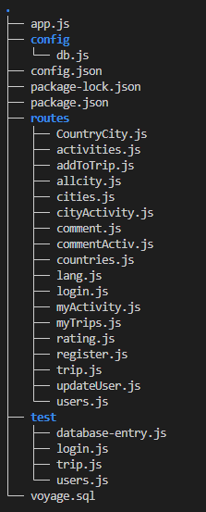
Express.js / node.js
Tree of API_Voyages =>

Slide 11
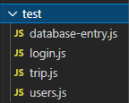
Tests
Mocha Chai

Slide 12
4 - Frontend

Slide 13
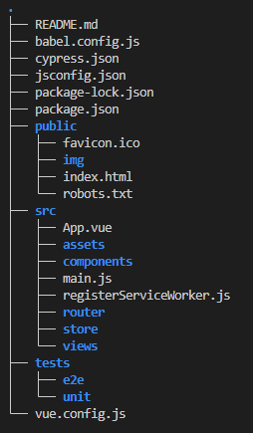
Vue.js
Tree of front-v =>

Slide 14
5 - Pages of the website

Slide 15
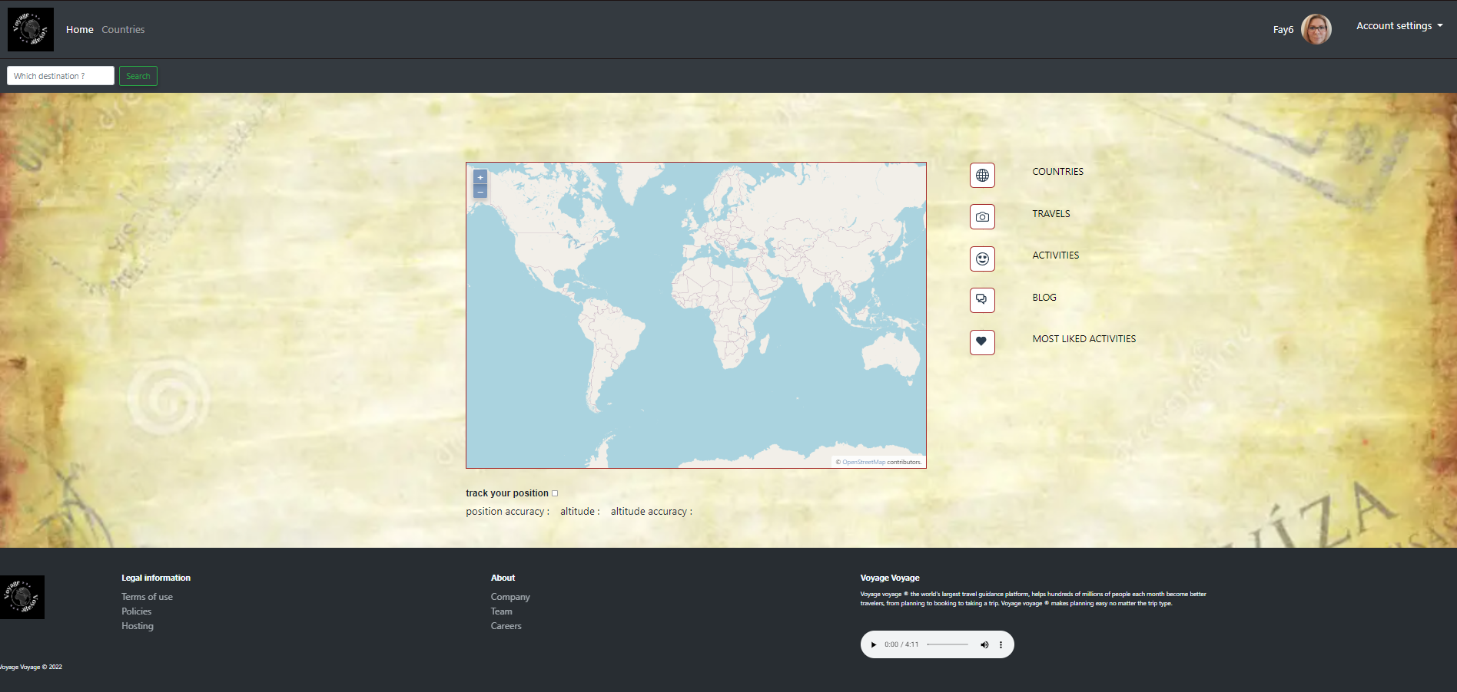
Home page

Slide 16
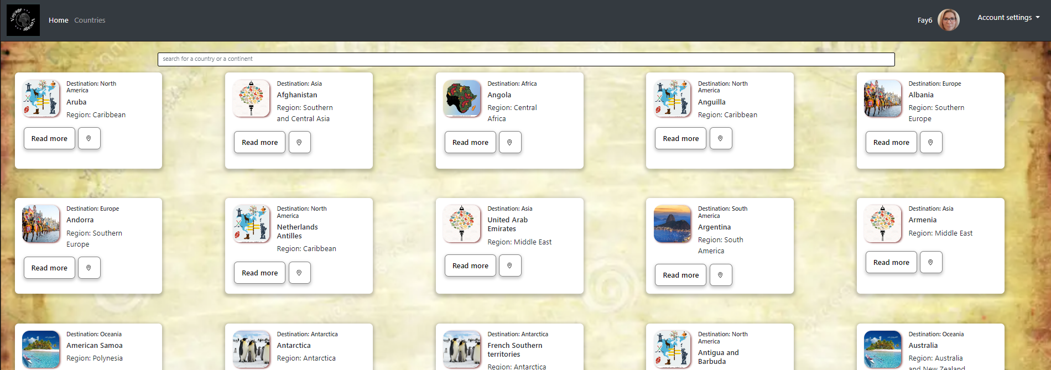
All countries
See all countries
Searchbar select country or continent

Slide 17
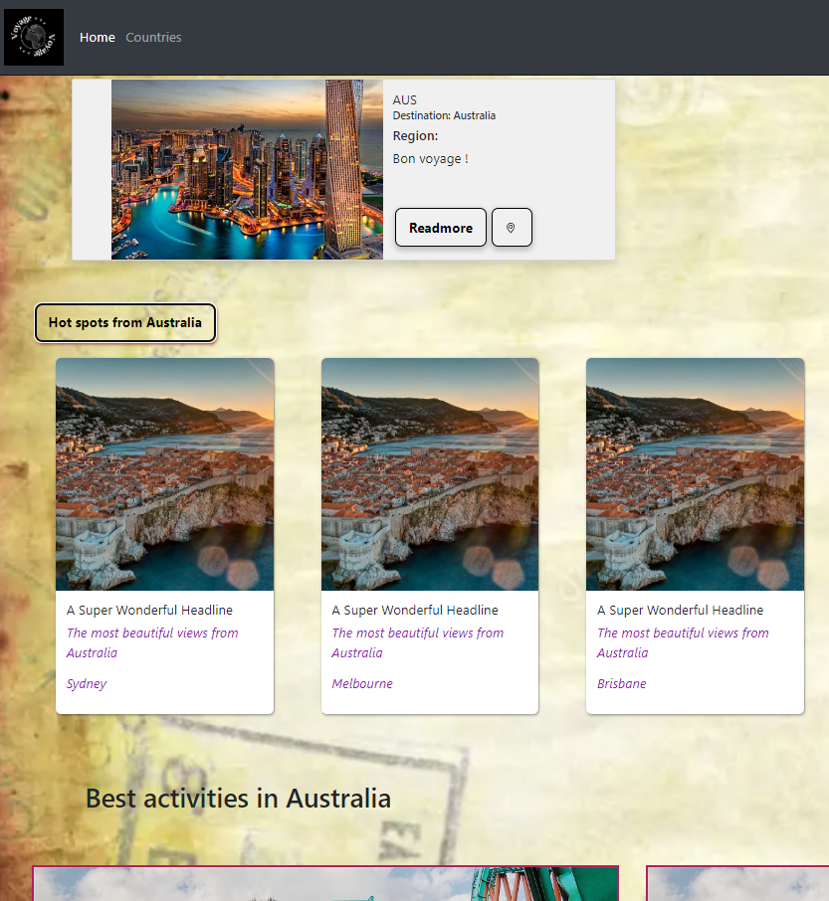
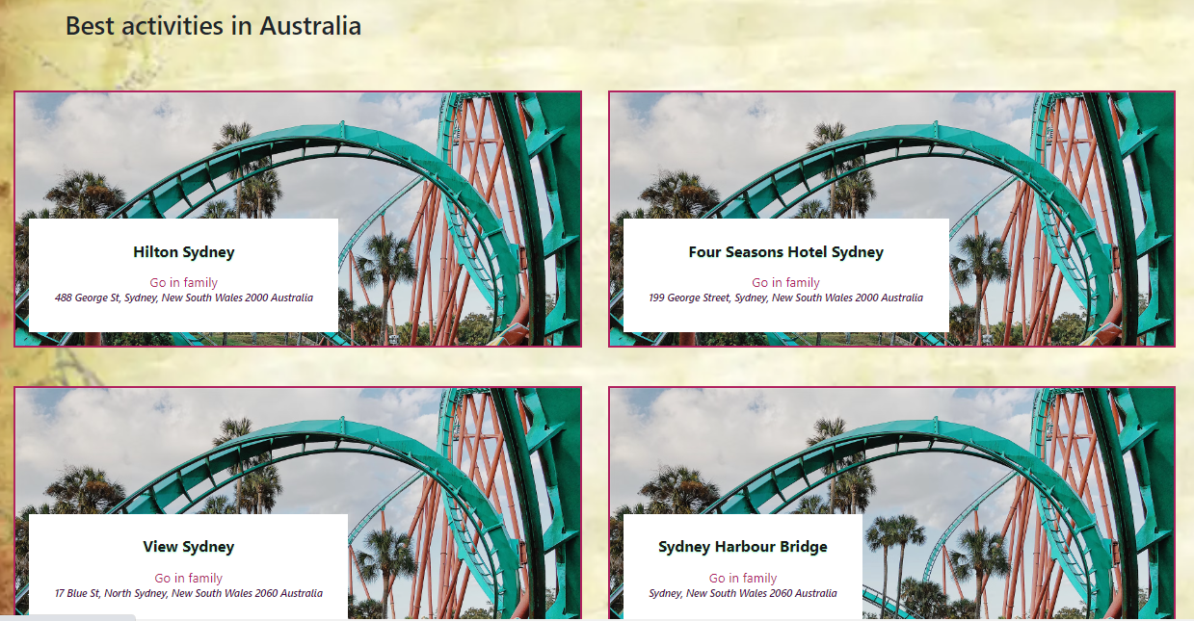
One country, cities and best activities

Slide 18
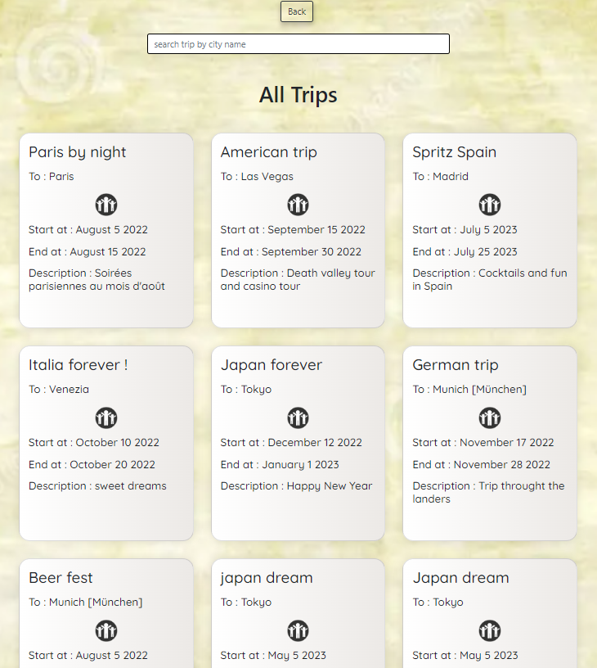
Travel news feed
All trips offered by users
Search by city name

Slide 19
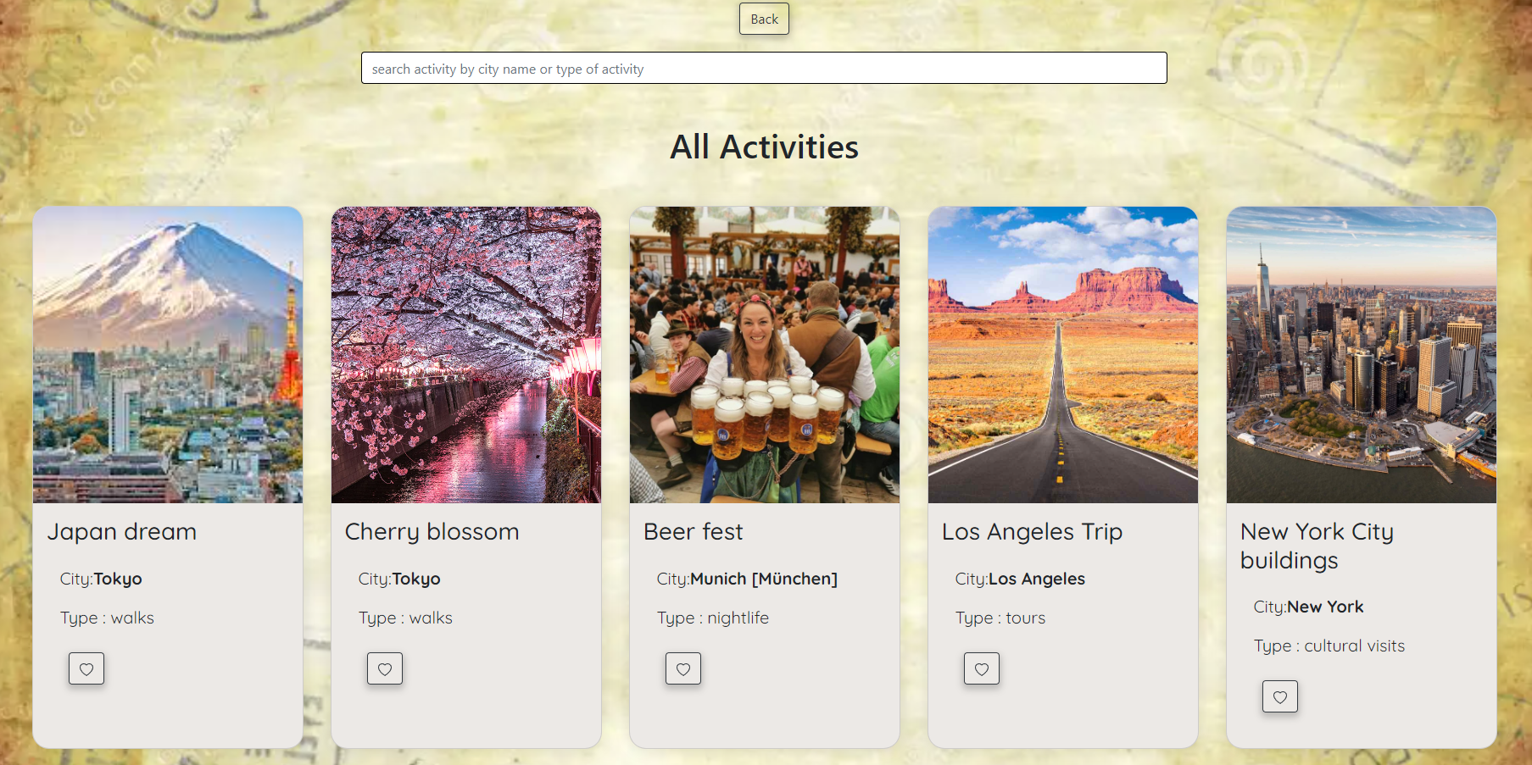
All Activities
See all activities
Comment and rate each activity

Slide 20
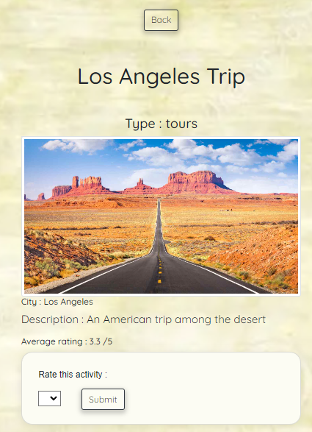
Rate :
Rate activity /5
See average rating for this activity

Slide 21
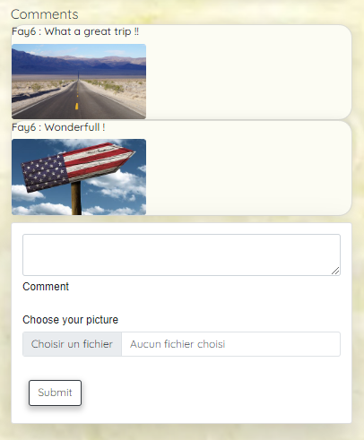
Comment :
Comment the activity
Add your picture

Slide 22
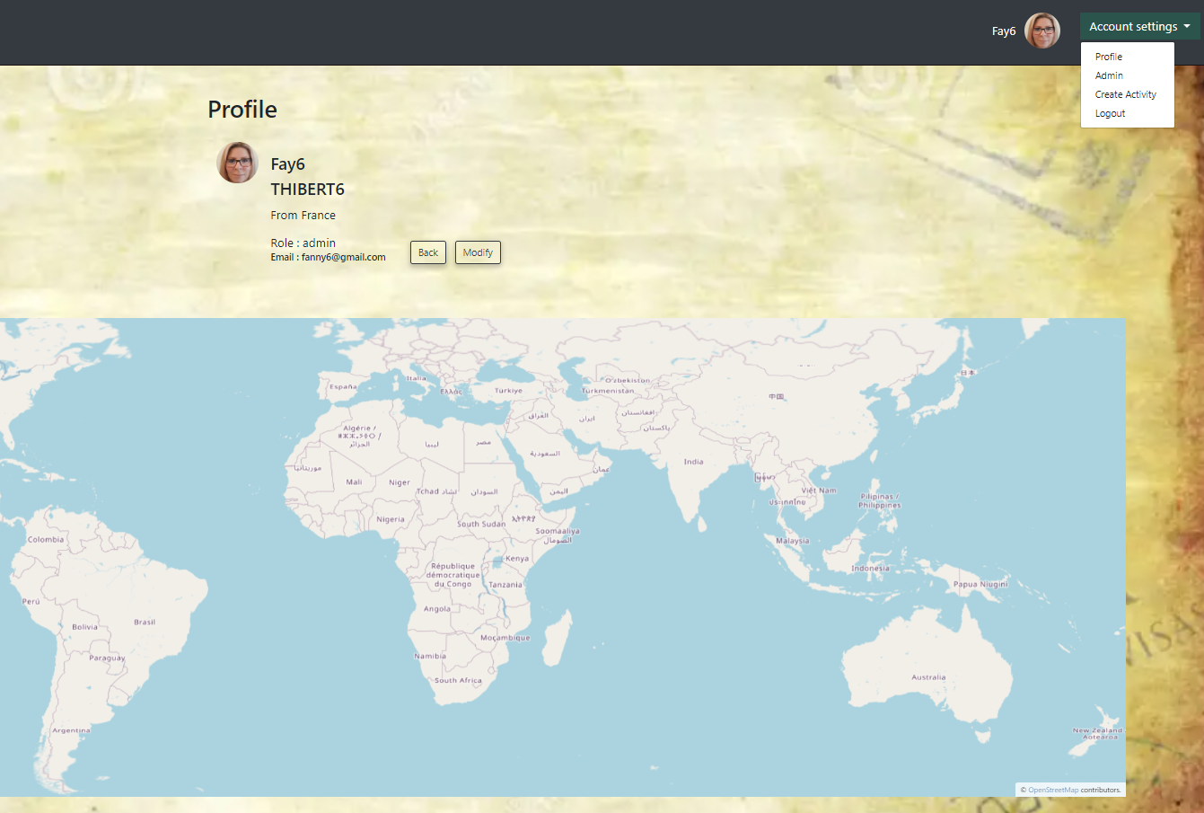
Profile page
Access to the details of the user
Possibility to modify informations
Interactive map

Slide 23
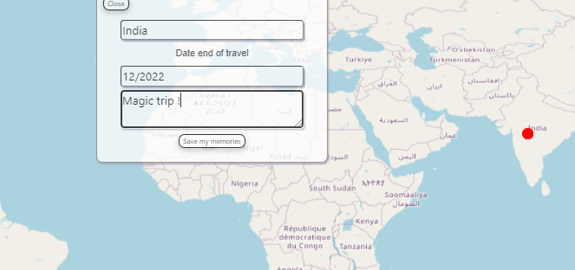
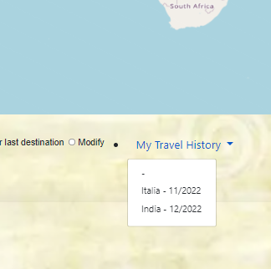
Save trips
Select map and save trips
Display all past trips

Slide 24
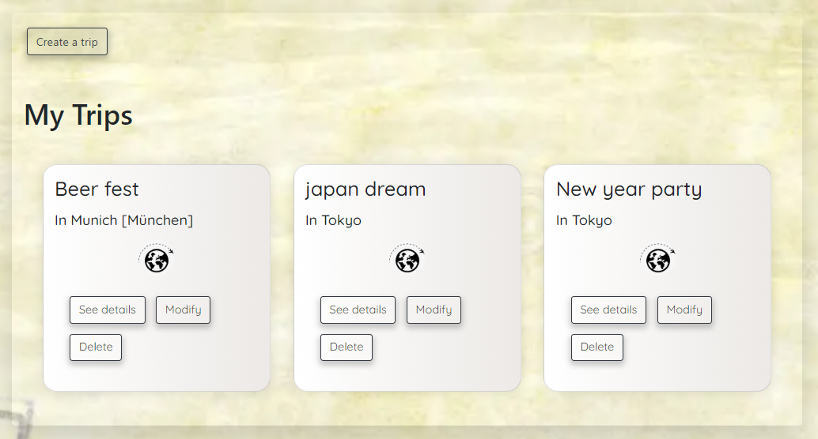
My Trips :
Create a trip
See details of each trip
Add activities to a trip
Modify informations on each trip
Delete trip

Slide 25
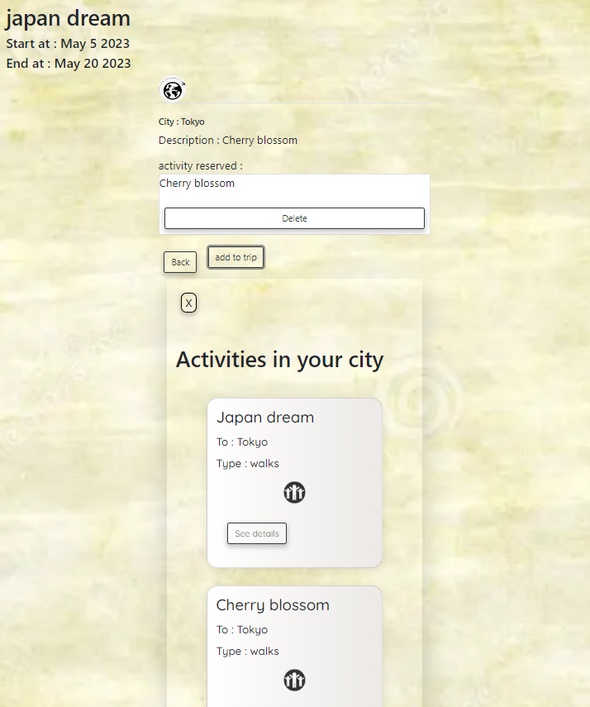
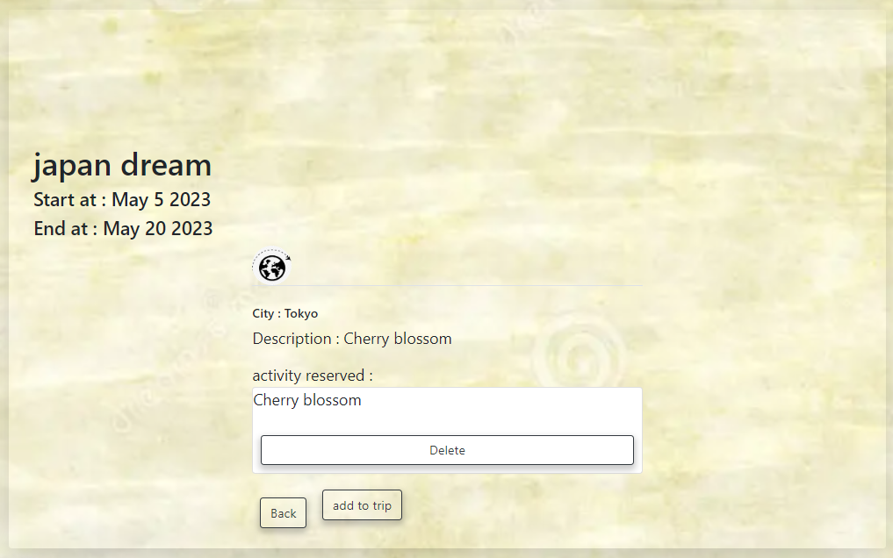
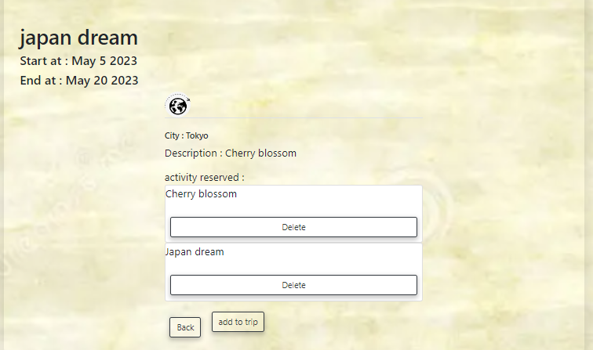
Add activities
Add activities to a trip by city

Slide 26
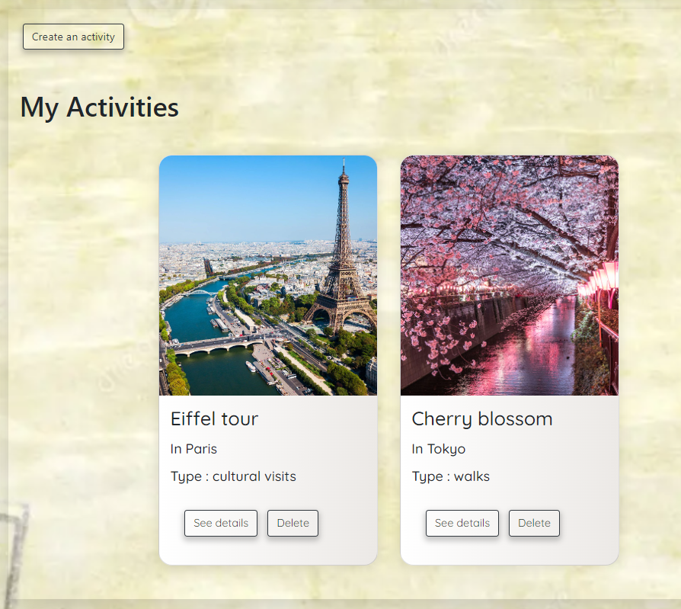
My Activities
Only Curators :
Create an activity
See details
Delete

Slide 27
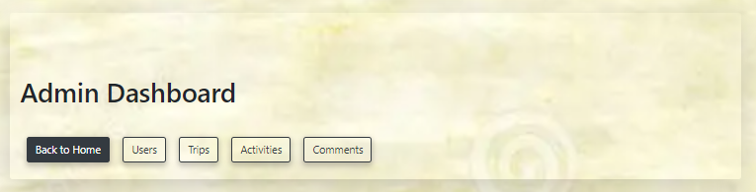
Admin dashboard

Slide 28
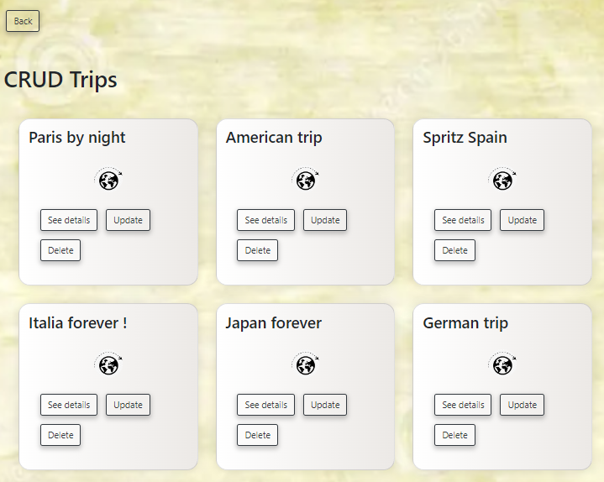
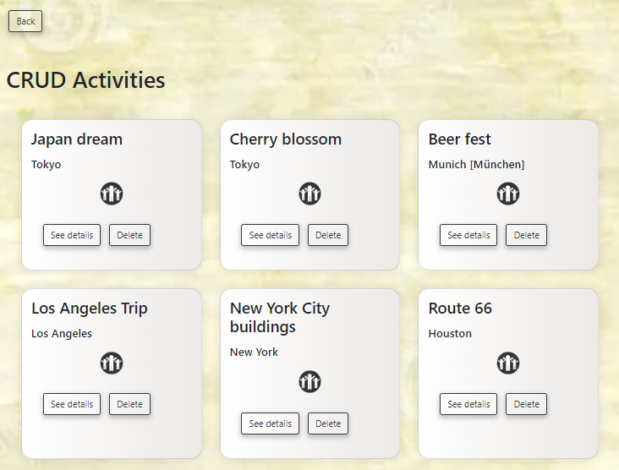
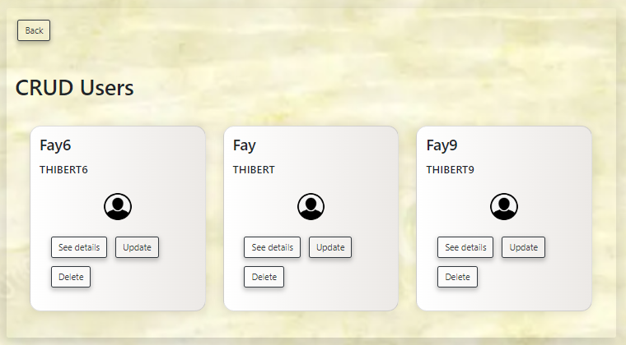
CRUDs

Slide 29
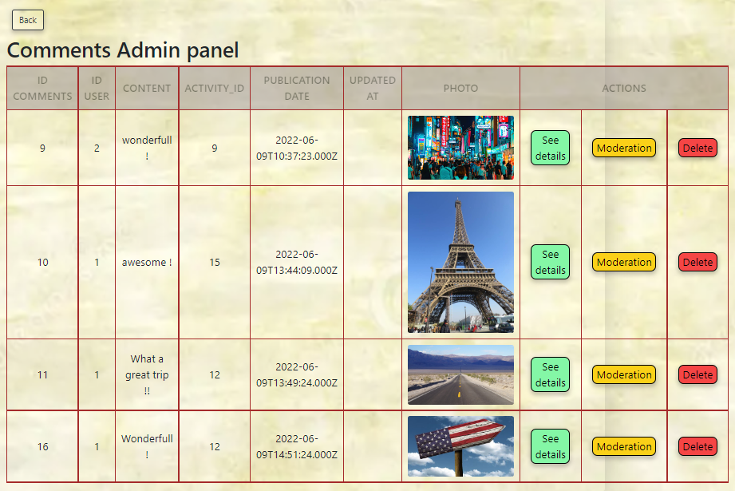
CRUD comments
Possibility to moderate

Slide 30
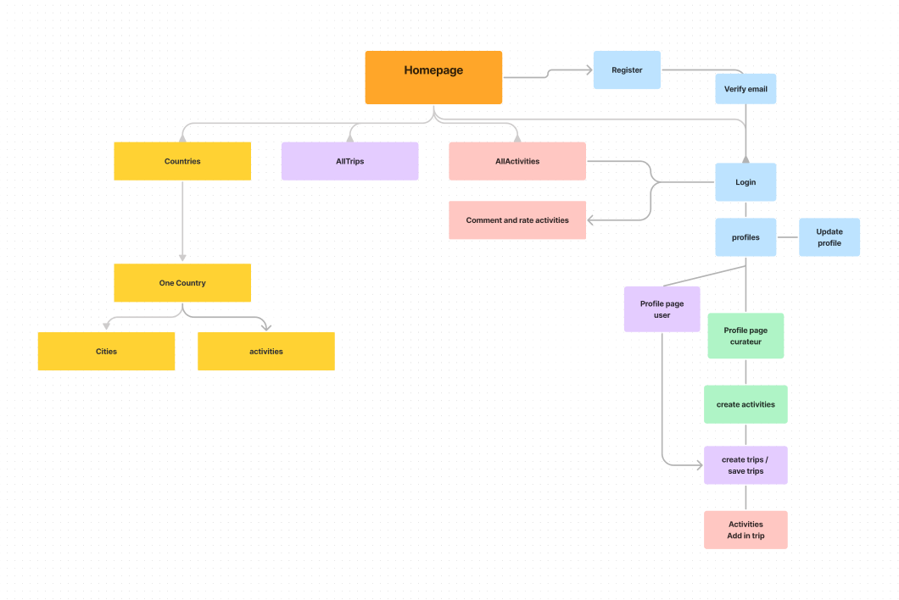
Plan of the website => User/Curators

Slide 31
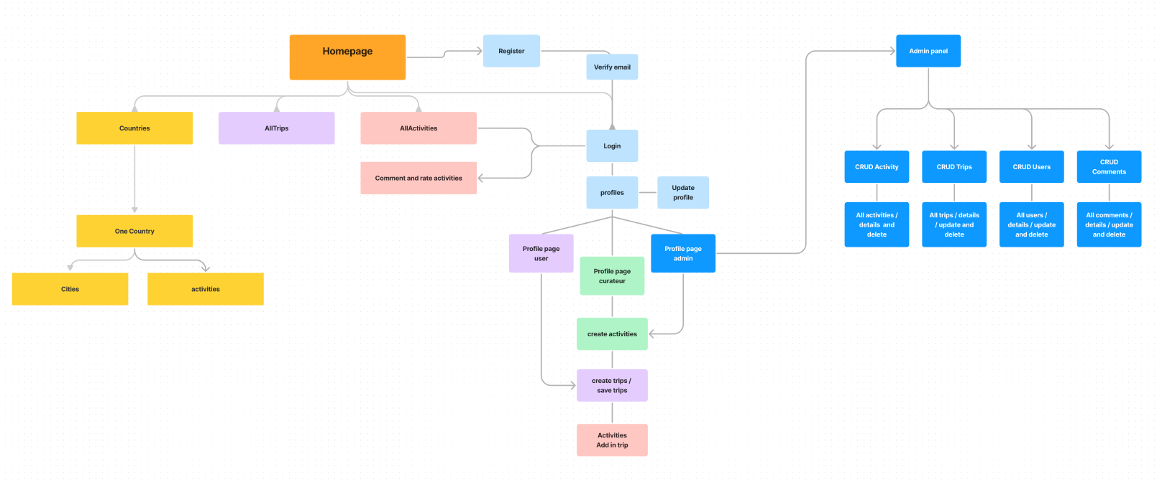
Plan of web the site => Admin

Slide 32
6 - Bonus

Slide 33
Logo Voyage Voyage

Slide 34
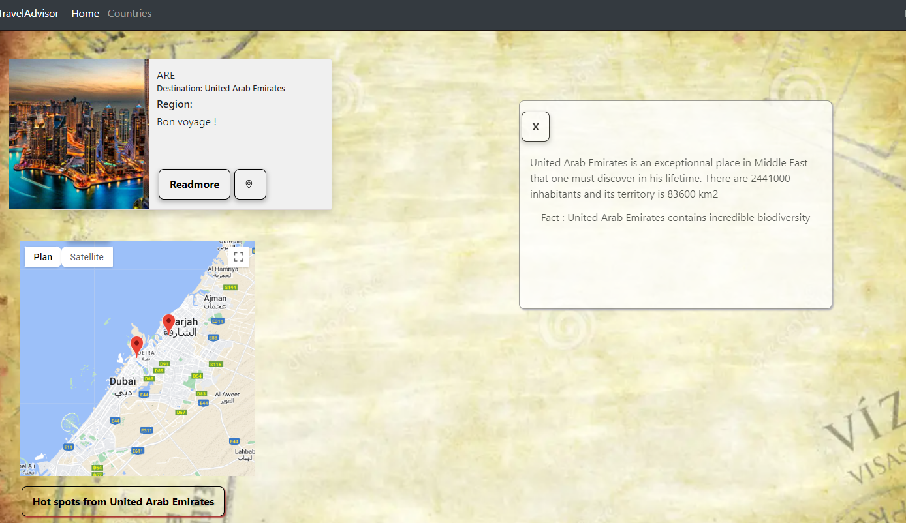
Facts and informations

Slide 35
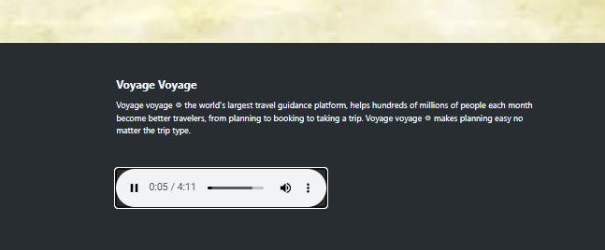
Musique ‘voyage voyage’

Slide 36
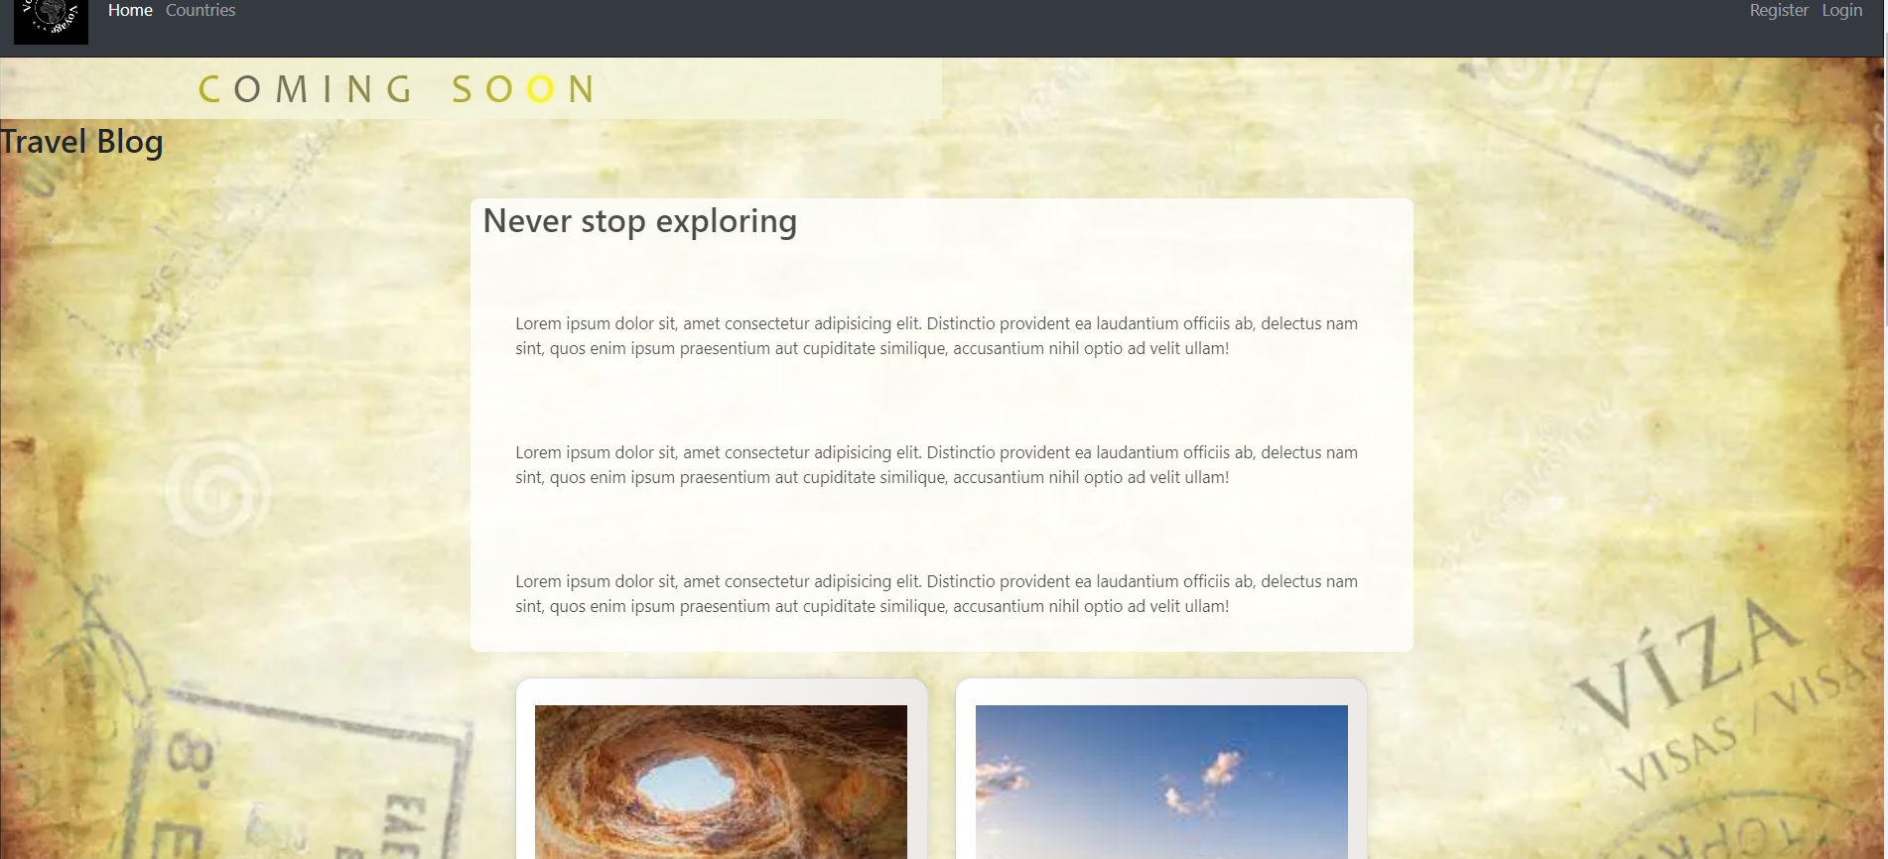
Blog

Slide 37
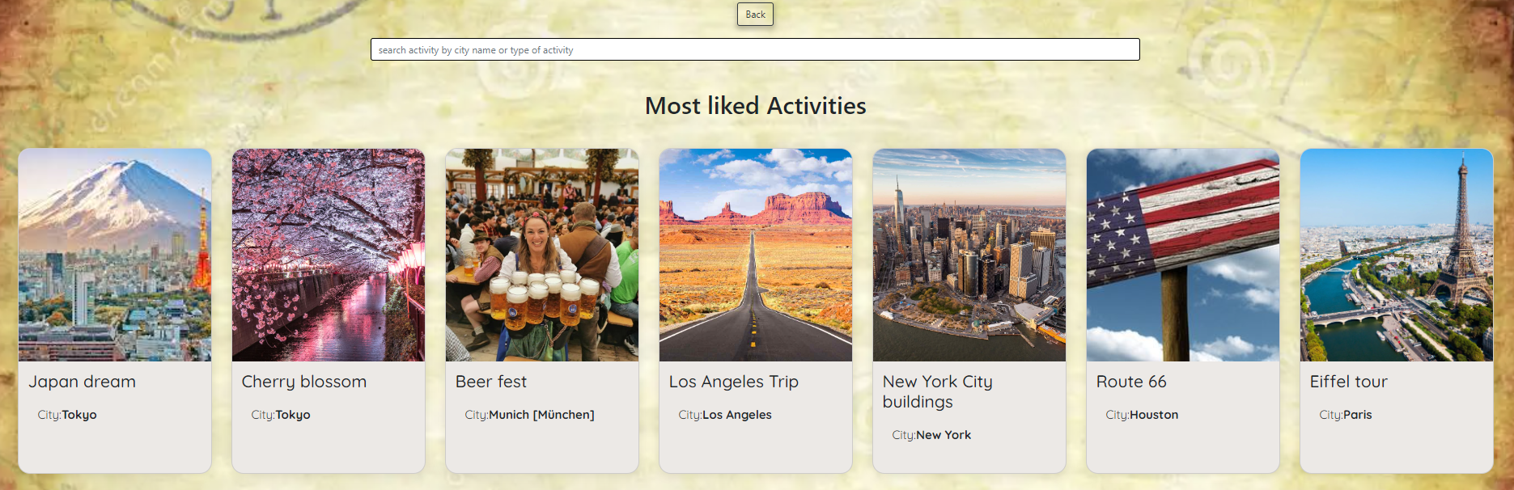
Most liked activities

Slide 38
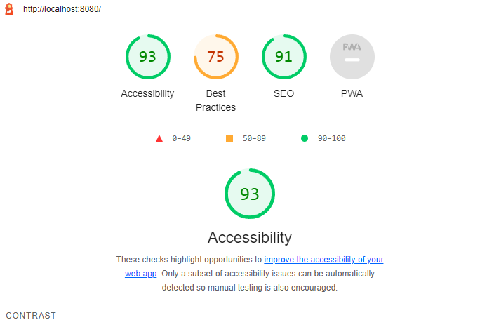
Google lighthouse

Slide 39
if we had to redo it :
Take more time to set the team organization at first
Identify more precisely all the requested specifications
Communicate regularly with the client
Better management of time and steps

Slide 40
Thank you for your time !

